Slide 1
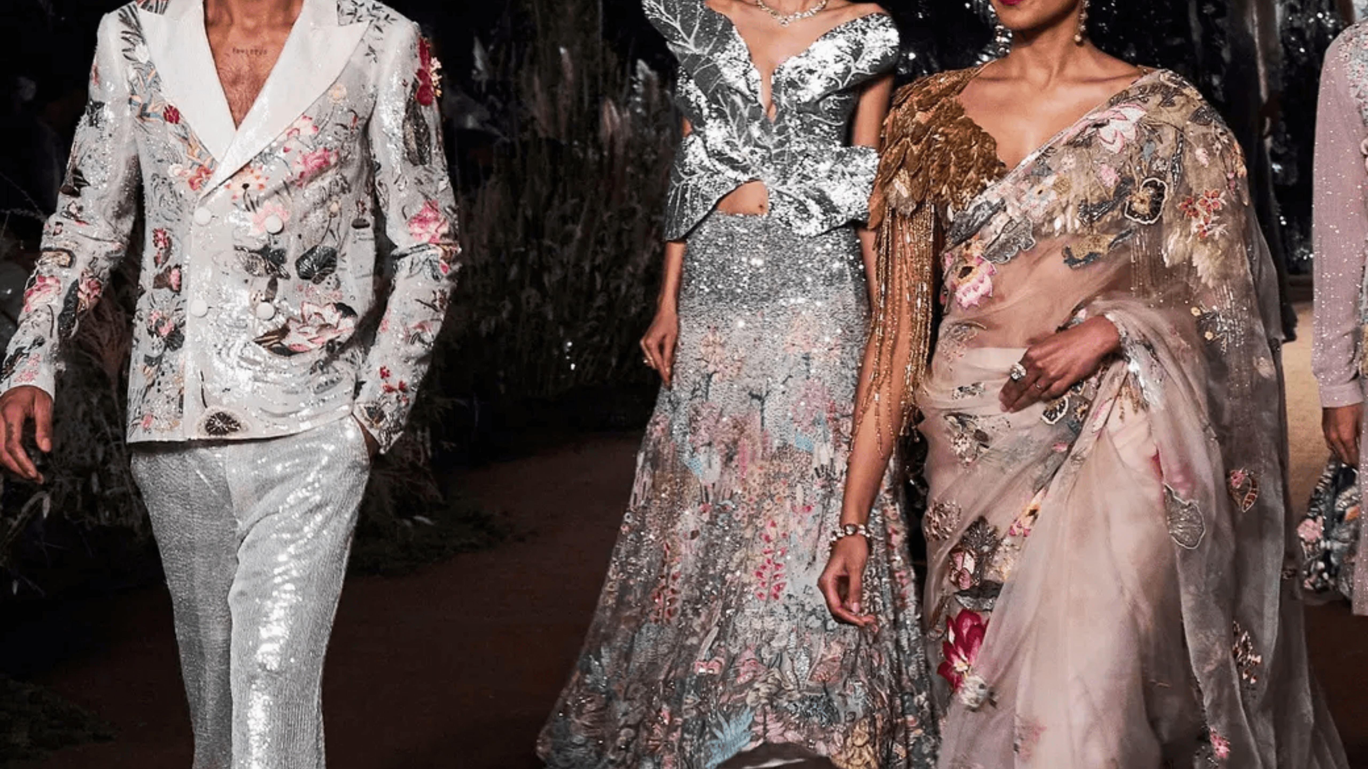
THREADS OF
TRUTH
Janani Vakkanti,Mrunal Y Dalvi,Sanchal Nachappa,Shriya Tarun,Suryah,Vadivel,Tejal Meda

Slide 2

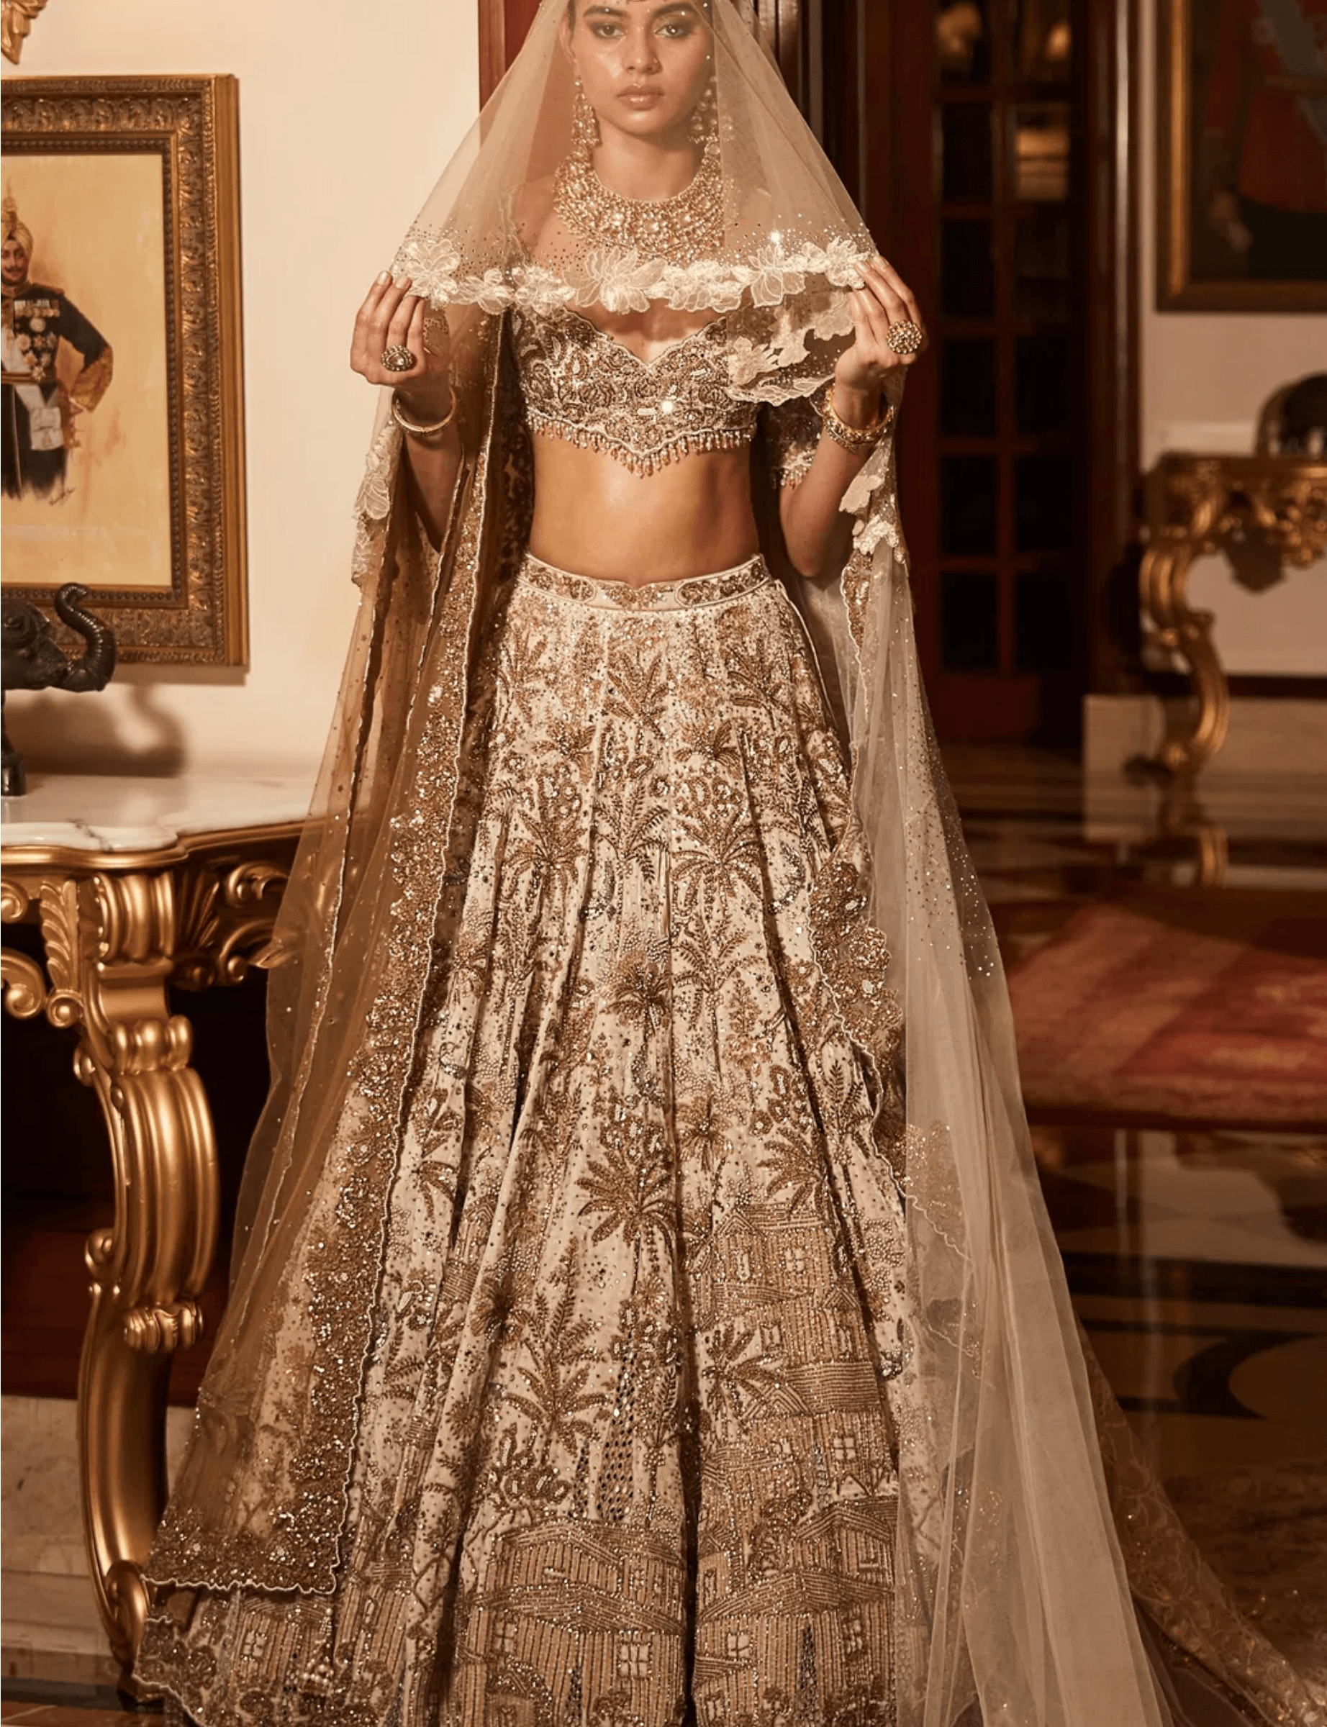
THE CHALLENGE
A Shifting Landscape
The global fashion industry, valued at over $1.7 trillion, is at a definitive turning point. A fundamental shift in consumer values is challenging the established cycle of trends. Today, 67% of consumers report prioritizing sustainability in their purchasing decisions.​ This creates an environment of unprecedented pressure, especially for cultural arbiters like Vogue India. ​
​
The publication must navigate a deep and volatile conflict:​ How does a leading voice like Vogue India balance the commercial pressure of disposable trends with the profound cultural and market shift towards authentic, sustainable craftsmanship?​

Slide 3

A
OUR METHODOLOGY
Data Scraping, Labeling & Sentiment Analysis
We scraped articles and images from Vogue India, focusing on bridal, runway, and streetwear trends to analyze sentiment evolution over time. Using image labeling techniques, we categorized fashion imagery by traditional vs. modern craftsmanship. Sentiment analysis tracked consumer emotions across categories.
"Data-driven insights transform trends into strategy."
Data Collection
Image Labeling
Scraped Vogue India articles and imagery across bridal, runway, streetwear
Categorized fashion imagery by traditional vs. modern craftsmanship
Sentiment Analysis
Topic Modeling
Tracked consumer emotions and sentiment shifts across categories
Uncovered emerging themes: sustainable luxury, heritage, fusion fashion

Slide 4
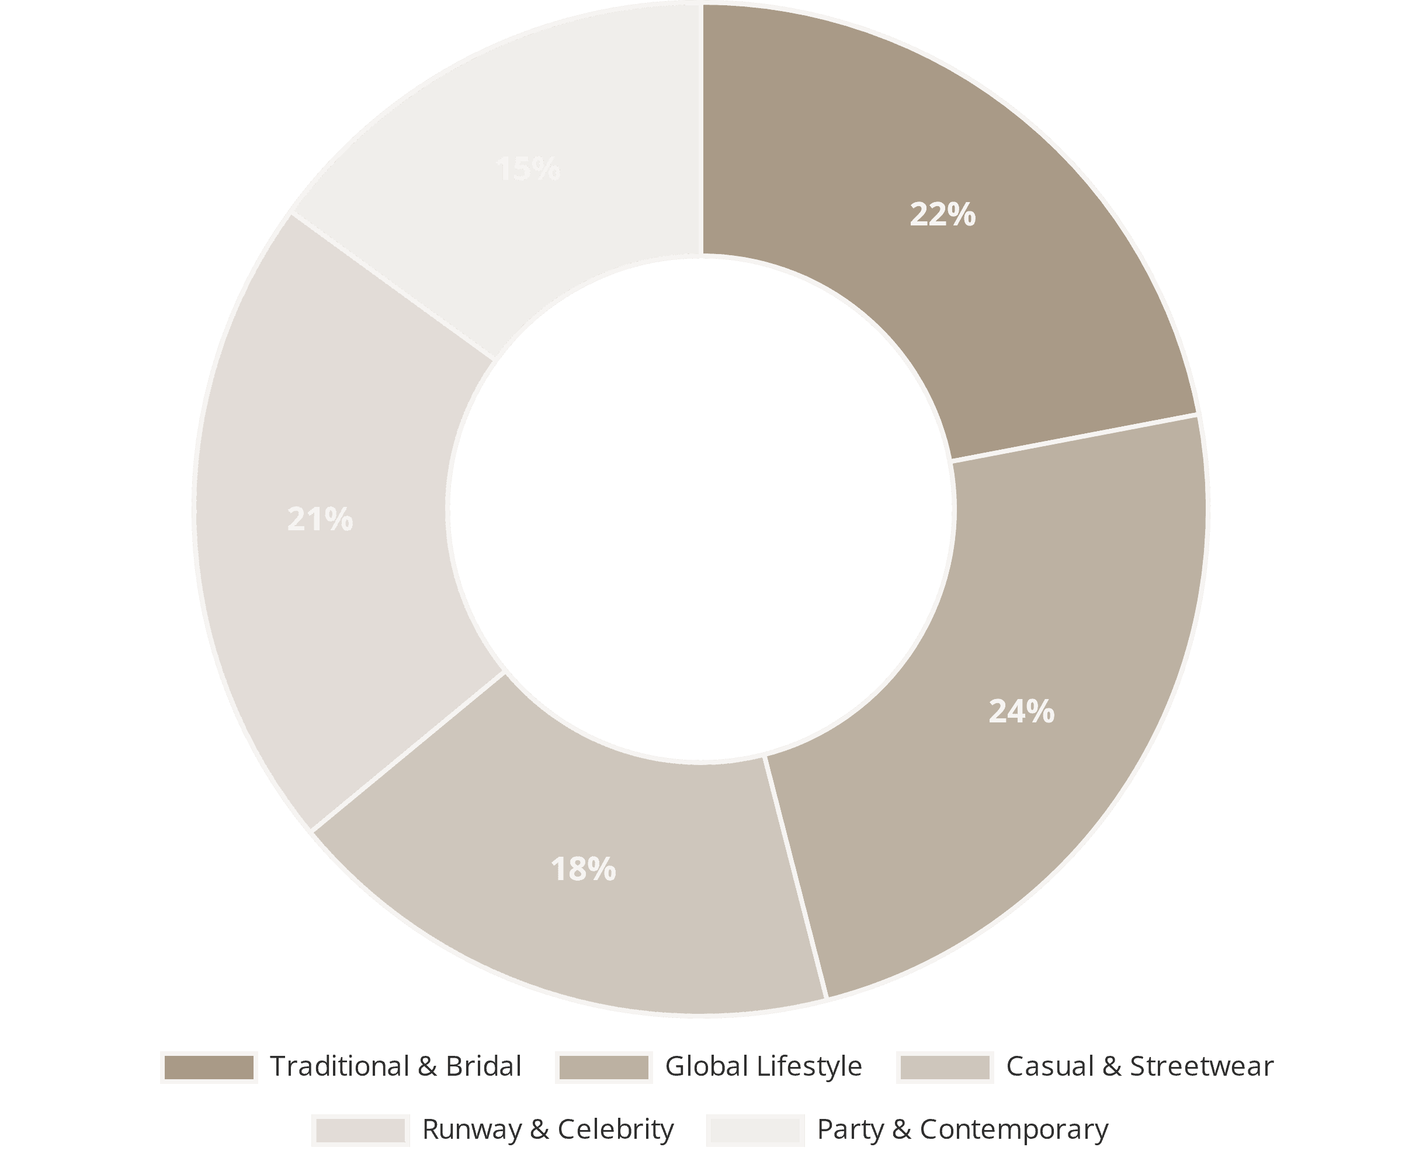
B
TOPIC ANALYSIS
Topic Modeling: Unveiling Fashion's Editorial DNA
Applied LDA topic modeling on ~1,000 Vogue India articles, extracting 5 recurring themes. This reveals that heritage and modernity coexist, with editorial coverage mirroring sentiment shifts toward authenticity and craftsmanship over fast fashion narratives.
"Editorial coverage mirrors sentiment evolution."
Traditional & Bridal
Global Lifestyle
22% - Heritage, craftsmanship, cultural identity
24% - Designer brands, global perspectives
Casual & Streetwear
Runway & Celebrity
18% - Everyday wear, seasonal trends
21% - Red-carpet, runway collections

Slide 5
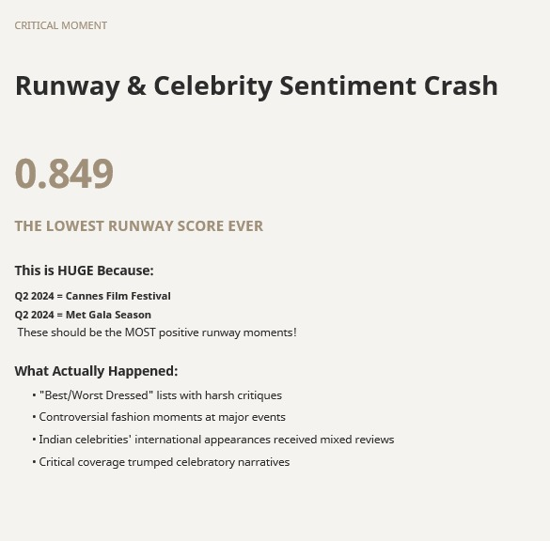
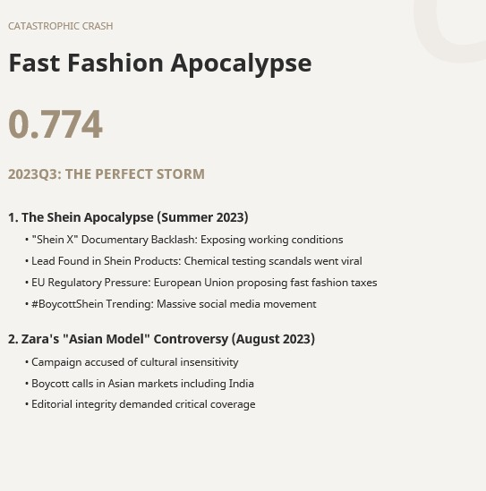
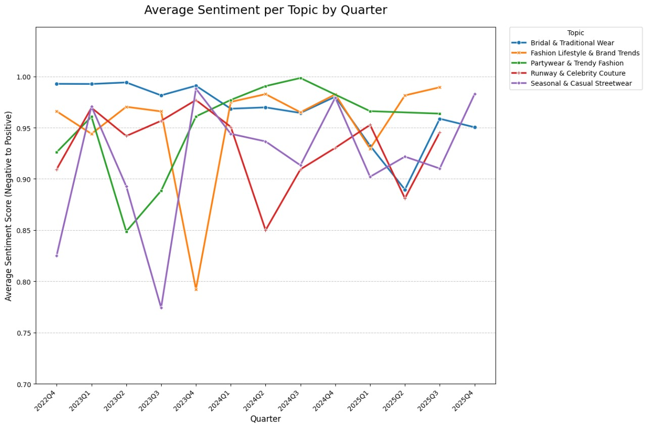

Slide 6
E
HERITAGE & INNOVATION
The Haute Couture Renaissance: Designer Prominence & Artisan Empowerment
Labour Hours Articles: Evolution, Not Glorification
Vogue India's coverage of labour-intensive craftsmanship reflects haute couture's growing prominence in India:
2023
2024
2025
4
11
19
Articles
Articles
Articles
This growth celebrates artisan excellence—not exploitation.
Designer Prominence
Artisan Empowerment
Sabyasachi Mukherjee
• Livelihood Support: Designers actively support traditional craft clusters
Engages 3,000+ artisans across 18 craft clusters in Kashmir, Uttar Pradesh, and West Bengal
• Heritage Preservation: Couture preserves rich heritage through modern fusion
Manish Malhotra
• Historical Research: Designers research folk patterns and artistic disciplines
Known for stunning embroidery and high-quality materials defining successful designer outfits
• Protecting Skills: Craftsmanship is monetarily supported and respected
Tarun Tahiliani & Rahul Mishra
• Future Generations: Age-old traditions passed forward to ensure heritage survival
Guarantee livelihood prospects for rural craftsmen while preserving heritage

Slide 7

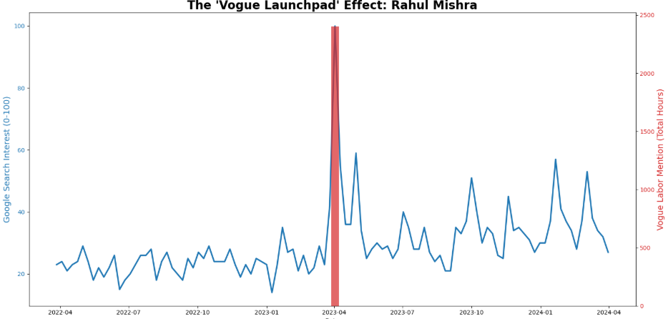
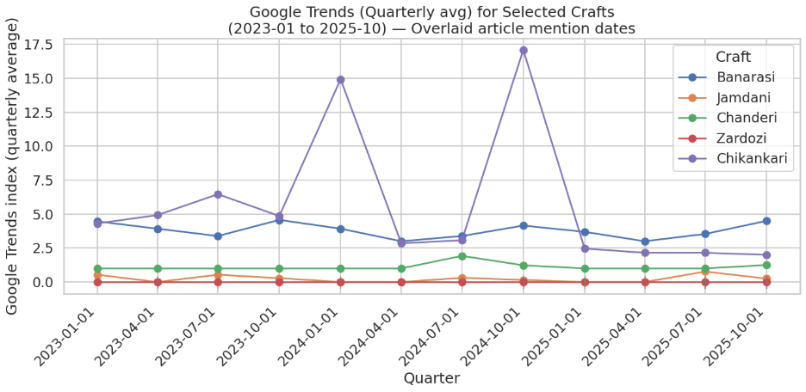
F
EDITORIAL IMPACT & GOOGLE TRENDS
Vogue Mentions Meet Google Trends: The Designer & Craft Effect
Designer Visibility: Rahul Mishra's Journey
Craft Visibility: Artisan Techniques Rise
Rahul Mishra launched his collection in 2014, but his trajectory changed dramatically when he became the first Indian designer invited to showcase at Haute Couture Week in Paris.
Couture pieces require hours of meticulous embroidery and traditional artisan craftsmanship. When Vogue India features these pieces, Google Trends for the underlying craft techniques spike in correlation with article mentions, creating awareness and demand.
2014: Collection Launch
Rahul Mishra establishes his brand with handcrafted excellence
Chikankari Embroidery
2023: Haute Couture Week Paris Invitation
Banarasi Weaving
First Indian designer to showcase at this prestigious global stage
Google Trends Spike & Sustained Growth
After the Paris showcase, Rahul Mishra's Google Trends increased dramatically and have remained elevated since.
[Graph: Rahul Mishra Google Trends Timeline]
[Graph: Craft Technique Google Trends Correlation]

Slide 8
G
MARKET EVOLUTION & SUSTAINABILITY
Fusion Fashion: The Evolution of Hybrid & Sustainable Luxury
Merging Traditional Indian Artistry with Contemporary Global Design
The primary effect of haute couture in India is its role in creating a distinct "India Modern" luxury aesthetic—a seamless fusion where Western concepts of cut, construction, and finish merge with Indian tradition and handcrafted excellence.
Elevating Heritage & Craftsmanship
Haute couture utilizes India's immense wealth of intricate craftsmanship. Designers have incorporated indigenous handwoven textiles, folk patterns, and regional art forms into contemporary work.
Zardozi
Banarasi Weaving
Block Printing
Gold thread embroidery elevating contemporary silhouettes
Ancient silk techniques meeting modern design
Traditional printing on modern minimalist shapes
Fusion & Hybridization: Dissolving Boundaries
Rigid boundaries between high fashion and everyday clothing have dissolved. The "Craftsmanship Crossover" applies couture techniques (intricate embroidery) to modern silhouettes—embroidered sweatshirts, zardozi denim, block-printed minimalist cuts—creating sustainable hybrid fashion.
Opulence, Heritage & Luxury Redefinition
High-profile events like Rohit Bal's tribute at Blenders Pride Fashion Tour emphasize drawing from India's rich craft traditions to create majestic, history-drenched garments woven from silk and gold thread. Couture with a traditional twist is now considered the luxury fashion of India, redefining global luxury aesthetics.
The India Modern Aesthetic: Where tradition meets innovation, sustainability meets opulence, and every stitch celebrates heritage while embracing the future.

